Slide 1
Spring Boot Caching With Redis
Subramanian Murugan

Slide 2
What is Caching
In computing, a cache is a component that transparently stores data so that future requests
for that data can be served faster.
The data that is stored within a cache might be values that
have been computed earlier or duplicates of original values that are stored elsewhere.

Slide 3
What is memory caching?
Memory caching (often simply referred to as caching) is a technique in which computer applications temporarily store data in a computer’s main memory (i.e., random access memory, or RAM) to enable fast retrievals of that data

Slide 4
What is memory caching?
The RAM that is used for the temporary storage is known as the cache. Since accessing RAM is significantly faster than accessing other media like hard disk drives or networks, caching helps applications run faster due to faster access to data

Slide 5
Distributed Cache
A distributed cache is a system that pools together the random-access memory (RAM) of multiple networked computers into a single in-memory data store used as a data cache to provide fast access to data.
While most caches are traditionally in one physical server or hardware component, a distributed cache can grow beyond the memory limits of a single computer by linking together multiple computers–referred to as a distributed architecture or a distributed cluster–for larger capacity and increased processing power

Slide 6
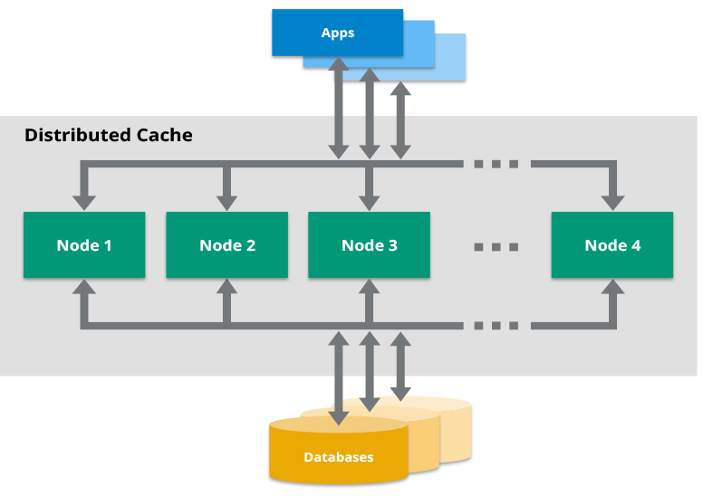

Slide 7
Cache Access Patterns
Write Through
Write Around
Write Back

Slide 8
Write Through Cache Pattern
When ever write request comes , write operation will be done in cache system.
From the Cache , data will be written to Database System.
Once Data is written in database successfully, acknowledgement will be sent to Client Application.

Slide 9
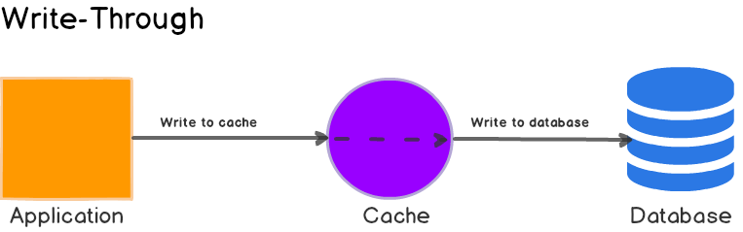
Write Through Cache Pattern

Slide 10
Write Around
Applications write data to database directly
When read requests, Application hits Cache
If no data found in the cache first time, Cache loads data from Database into caching system
If data found in the cache , data will be returned from cache itself.

Slide 11
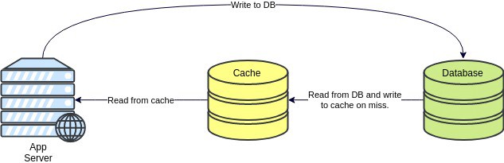
Write Around

Slide 12
Write Back
Application sends write requests to Cache System, once write is completed in Cache, Acknowledgement sent to Client Application.
There is background service, which starts writing data from Cache into Database Async.

Slide 13
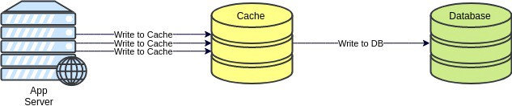
Write Back Pattern

Slide 14
CACHE EVICTION(Removal) POLICIES
The cached item(s) is released when the cached object(s) exceeds the quota to make up the space for the incoming new data.
The process of releasing blocks is called eviction

Slide 15
CACHE EVICTION(Removal) POLICIES
First In First Out (FIFO, QUEUE):
The cache evicts the first block accessed first regardless of any information about data (pretty dull)
Last In First Out (LIFO, STACK):
Removes the most recently accessed cache first irrespective of any information about data (pretty dull)
Least Recently Used (LRU):
Evicts the least recently used items.
Most Recently Used (MRU):
Evicts the most recently used items. (in contrast to LRU). MRU algorithms are most useful in situations where the older an item is, the more likely it is to be accessed
Least Frequently Used (LFU):
This one store counts of how often the item is needed. Evicts the lowest counts, meaning least commonly (frequently) used.
Random Replacement (RR):
Randomly selects a candidate item and discards it to make space when necessary (Not very useful)

Slide 16
Caching core concepts
Cache Hit
Cache Miss
Eviction

Slide 17
Cache Hit
Cache hit means the requested data already there in the cache.
This request can be served by simply reading the cache, which is comparatively faster.

Slide 18
Cache Miss
The data has to be recomputed or fetched from its original storage location
A cache miss occurs either because the data was never placed in the cache, or because the data was removed (“evicted”) from the cache by either the caching system itself or an external application that specifically made that eviction request.

Slide 19
Cache Eviction
Eviction by the caching system itself occurs when space needs to be freed up to add new data to the cache, or if the time-to-live policy(TTL) on the data expired

Slide 20
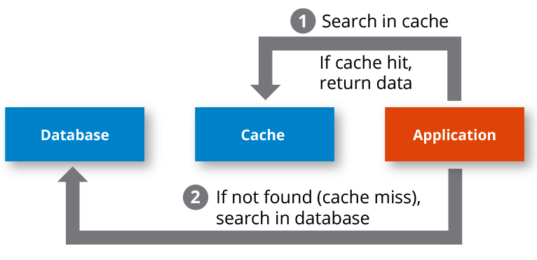
HIT OR MISS

Slide 21
Caching Implementations
Hardware cache
Network cache
Software caches
-Disk
-Web
-database
-networking
-application level

Slide 22
Spring Boot caching

